Slide 1


Capstone Project-1 EDA On Hotel Booking Analysis
BY- Sakshi P. Jadhav
Sandeep Salunke
(Cohort Enlighten)

Slide 2
PROBLEM STATEMENT
For this project we will be analyzing Hotel Booking data. This data set contains booking information for a city hotel and a resort hotel, and includes information such as when the booking was made, length of stay, the number of adults, children, and/or babies, and the number of available parking spaces.
Hotel industry is a very volatile industry and the bookings depends on above factors and many more.
The main objective behind this project is to explore and analyze data to discover important factors that govern the bookings and give insights to hotel management ,which can perform various campaigns to boost the business and performance.

Slide 3
Work Flow :
So we will divide our work flow into following 3 steps.
Data Collection and Understanding
Data Cleaning and Manipulation
Exploratory Data Analysis(EDA)
EDA will be divided into following 3 analysis.
1) Univariate analysis: Univariate analysis is the simplest of the three analyses where the data you are analyzing is only one variable.
2) Bivariate analysis: Bivariate analysis is where you are comparing two variables to study their relationships.
3) Multivariate anlysis: Multivariate analysis is similar to Bivariate analysis but you are comparing more than two variables.

Slide 4
Data Collection and Understanding:
Data Description:
hotel :Resort Hotel or City Hotel
is_canceled : Value indicating if the booking was canceled (1) or not (0)
lead_time : Number of days that elapsed between the entering date of the booking and the arrival date
arrival_date_year : Year of arrival date
arrival_date_month : Month of arrival date
arrival_date_week_number : Week number of year for arrival date
arrival_date_day_of_month : Day of arrival date
stays_in_weekend_nights : Number of weekend nights
stays_in_week_nights : Number of week nights.
adults : Number of adults

Slide 5
Data Collection and Understanding:
children : Number of children
babies : Number of babies
meal : Type of meal booked.
country : Country of origin.
booking_changes : Number of changes/amendments made to the booking from the moment the booking was entered on the PMS until the moment of check-in or cancellation deposit_type : Indication on if the customer made a deposit to guarantee the booking. agent : ID of the travel agency that made the booking company : ID of the company/entity that made the booking or responsible for paying the booking. days_in_waiting_list : Number of days the booking was in the waiting list before it was confirmed to the customer customer_type : Type of booking, assuming one of four categories

Slide 6
DATA COLLECTION AND UNDERSTANDING:
adr : Average Daily Rate as defined by dividing the sum of all lodging transactions by the total number of staying nights required_car_parking_spaces : Number of car parking spaces required by the customer
previous_bookings_not_canceled : Number of previous bookings not cancelled by the customer prior to the current booking reserved_room_type : Code of room type reserved. Code is presented instead of designation for anonymity reasons. assigned_room_type : Code for the type of room assigned to the booking. required_car_parking_spaces : Number of car parking spaces required by the customer total_of_special_requests : Number of special requests made by the customer

Slide 7
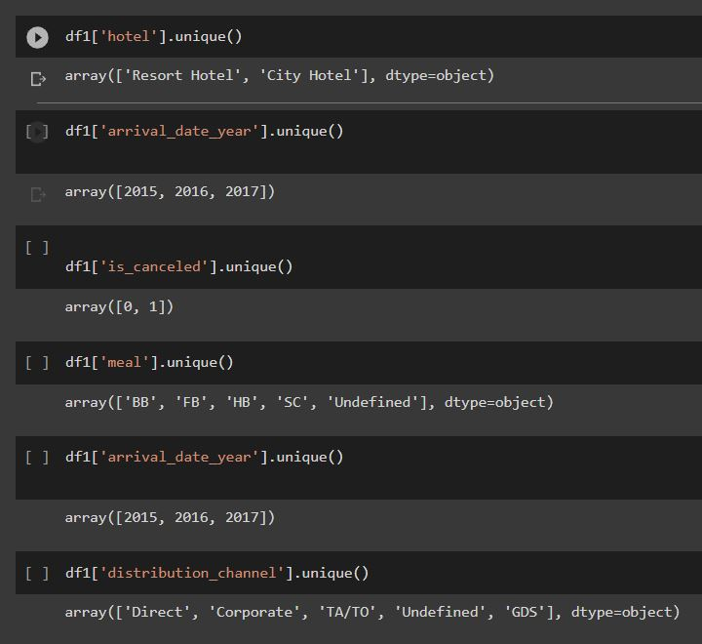
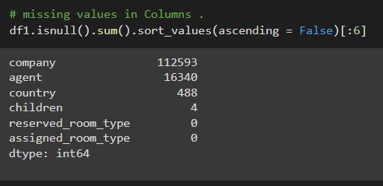
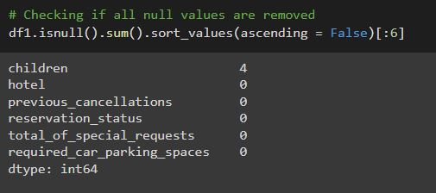
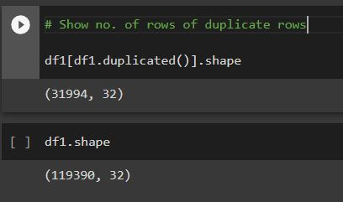
Data Cleaning and Manipulation:

Slide 8

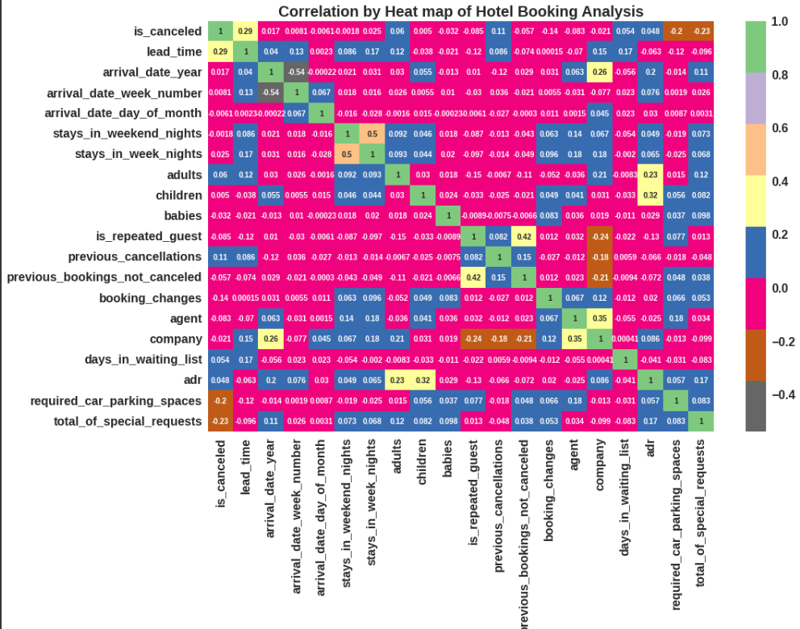
correlation matrix
1) Total stay length and lead time have slight correlation. This may means that for longer hotel stays people generally plan little before the the actual arrival.
2) adr is slightly correlated with total_people, which makes sense as more no. of people means more revenue, therefore more adr.
Lets see does length of stay affects the adr.
Conclusion:-
* Lead-time and total stay is positively correlated means more is the stay of customer more will be the lead time.
* ADR(average daily rate) and total people are highly correlated. That means more the people more will be the adr. High adr means high revenue.

Slide 9

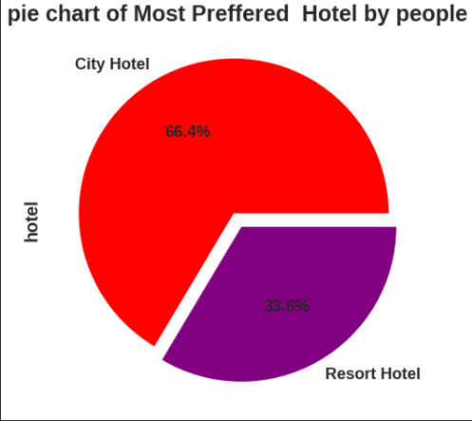
Exploratory Data Analysis(EDA)
Conclusion -
Most of the people stay In city hotel.

Slide 10
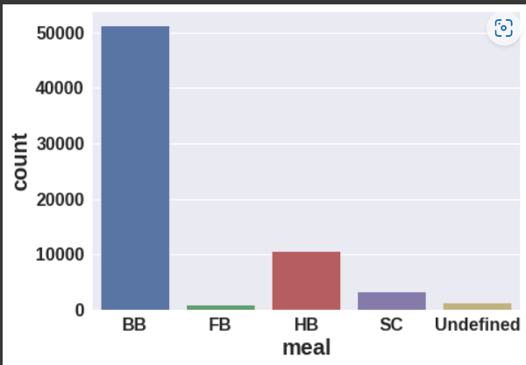
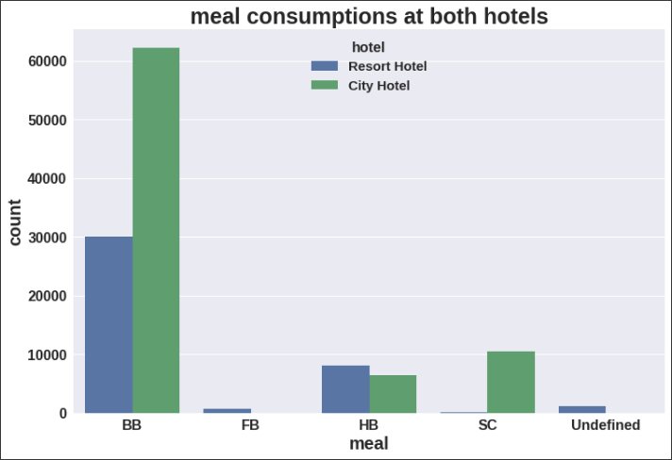
Exploratory Data Analysis(EDA)
Conclusion -
BB(bed & Beakfast ) is the most preffered type of meal by the guests.
Full board (FB) is least preffered.
HB and SC are equally preferred.

Slide 11
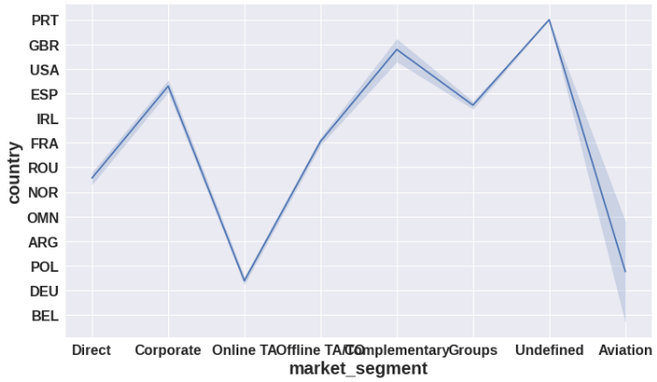
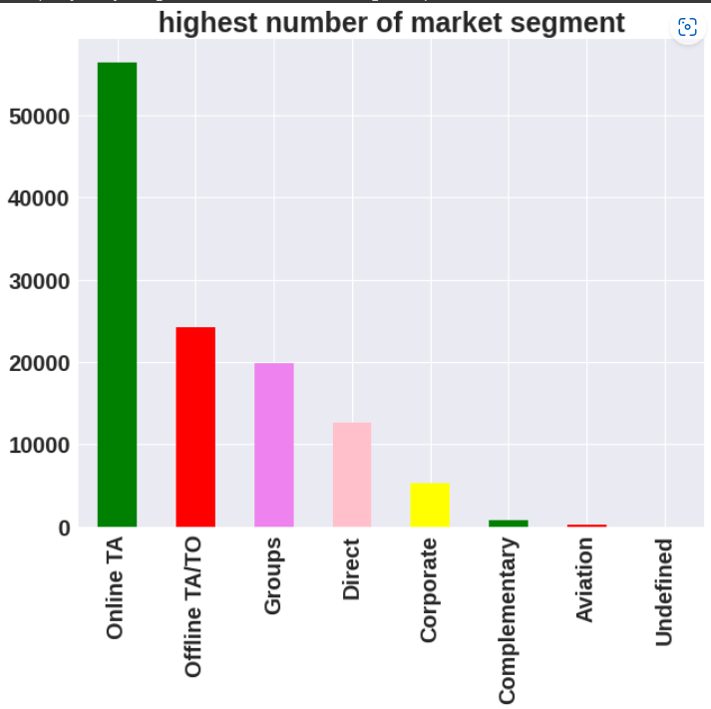
Exploratory Data Analysis(EDA)
Conclusion –
Here we can see that the most of guest are making reservation through Online TA channels which is travel agency and tour operator. •
Channel which is mostly used for early booking of hotels is also online TA and TA/TO.
Country PRT has highest count value.

Slide 12

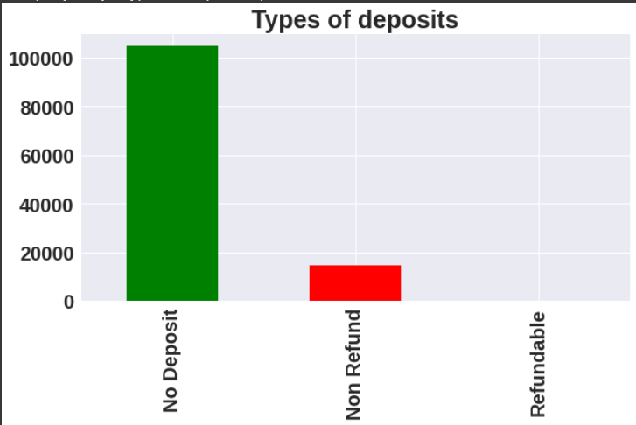
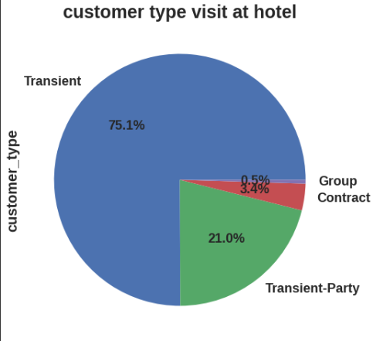
Exploratory Data Analysis(EDA)
Conclusion –
No deposit most preffered by people
Transient type of customer is most visit to hotel

Slide 13
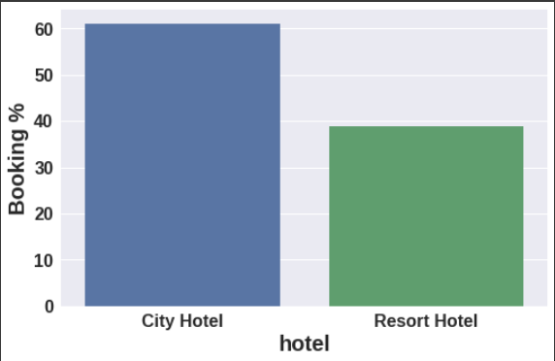
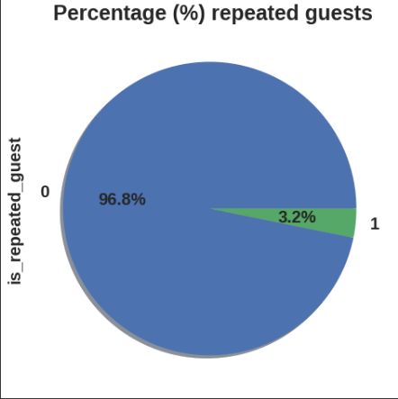
Exploratory Data Analysis(EDA)
Conclusion –
Around 60% bookings are for City hotel and 40% bookings are for Resort hotel.
The Percentage of both of hotels have repeated guests is 96.8% .

Slide 14
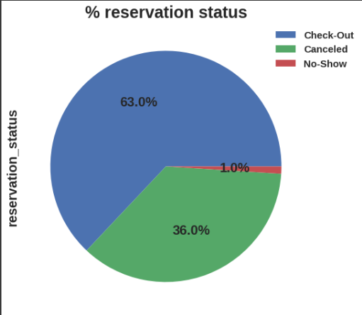
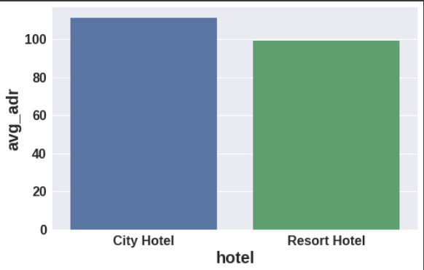
Exploratory Data Analysis(EDA)
Conclusion –
City hotel has maximum adr than resort Hotel
Avg adr of Resort hotel is slightly lower than that of City hotel. Hence, City hotel seems to be making slightly more revenue.

Slide 15
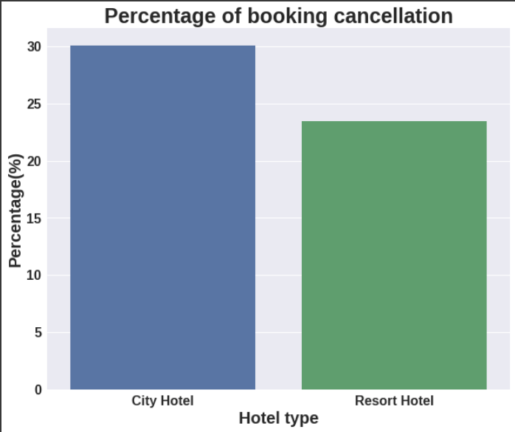
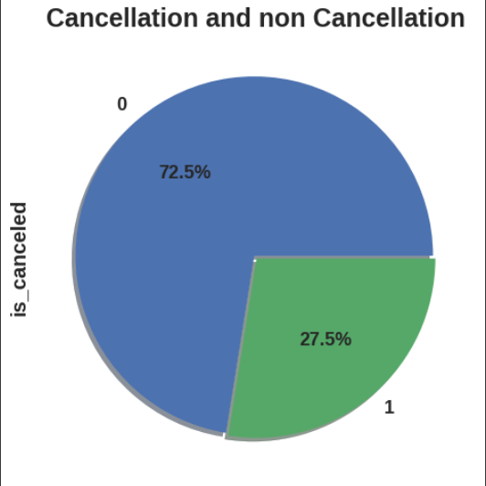
Exploratory Data Analysis(EDA)
Conclusion -
City Hotel have the Highest percentage of cancellation of bookings

Slide 16
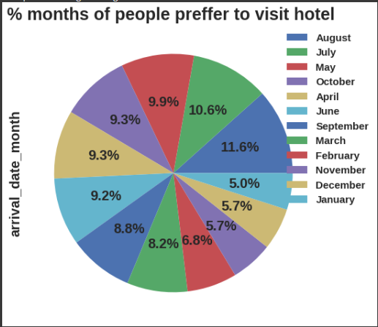
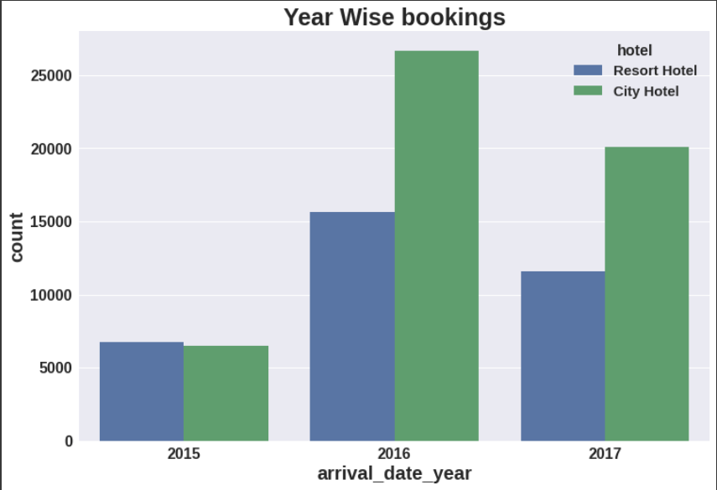
Exploratory Data Analysis(EDA)
Conclusion –
From the month of July to August the number of bookings increased and in August, City Hotel got most number of guests.
2016 Year have the highest bookings

Slide 17
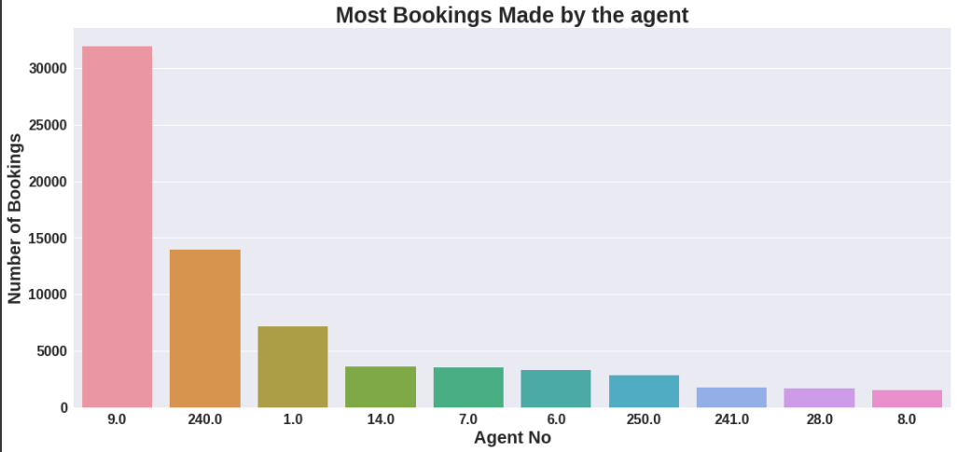
Exploratory Data Analysis(EDA)
Conclusion –
The graph shows agent no. 9 has maximum number of bookings and Agent number 8 has lowest number of bookings

Slide 18
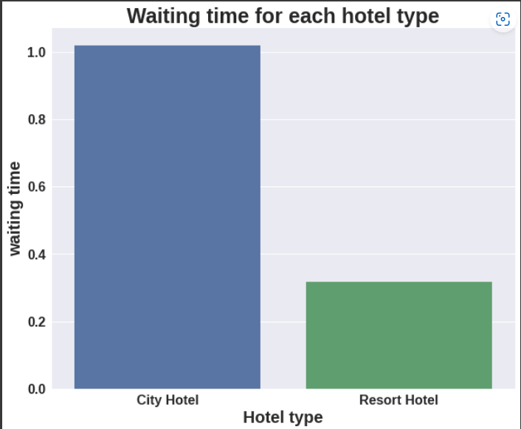
Exploratory Data Analysis(EDA)
Conclusion:
Waiting time period for City hotel is high as compared to resort hotels. That means city hotels are much busier than Resort hotels.

Slide 19
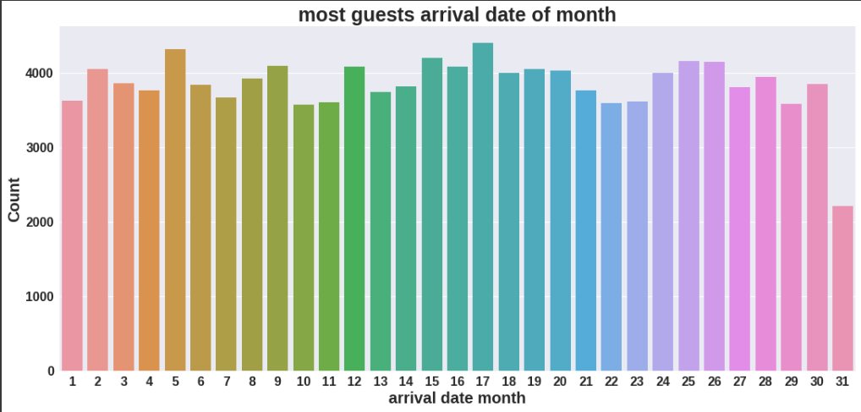
Exploratory Data Analysis(EDA)
Conclusion –
17th day of month is most visited by the guests.

Slide 20
THANK YOU…!!

